Slide 1
Ohio Sea Grant College Program and Stone Laboratory
Dr. Jeffrey M. Reutter
Director, Ohio Sea Grant & Stone Lab

Slide 2
Jeffrey M. Reutter, Ph.D., Director
1895—F.T. Stone Laboratory
1970—Center for Lake Erie Area Research (CLEAR)
1978—Ohio Sea Grant College Program
1992—Great Lakes Aquatic Ecosystem Research Consortium (GLAERC)

Slide 3
What is Ohio Sea Grant?
Part of National Sea Grant Collage Program in NOAA
32 programs—every coastal state
Partnership of:
  Government
  Academia
  Private Sector
Focus on 3 E’s:
  Environment
  Economy
  Education
Accomplish through:
  Research
  Education
  Outreach

Slide 4
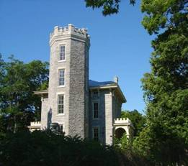
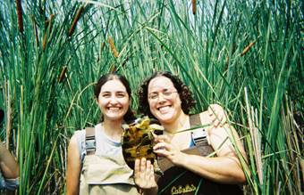
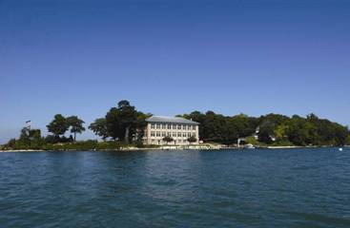
What is Stone Lab?
Oldest freshwater field station in the nation
Ohio’s Lake Erie Lab since 1895
Island campus of OSU on Gibraltar Island, Lake Erie
Research, education, and outreach laboratory for Ohio Sea Grant

Slide 5
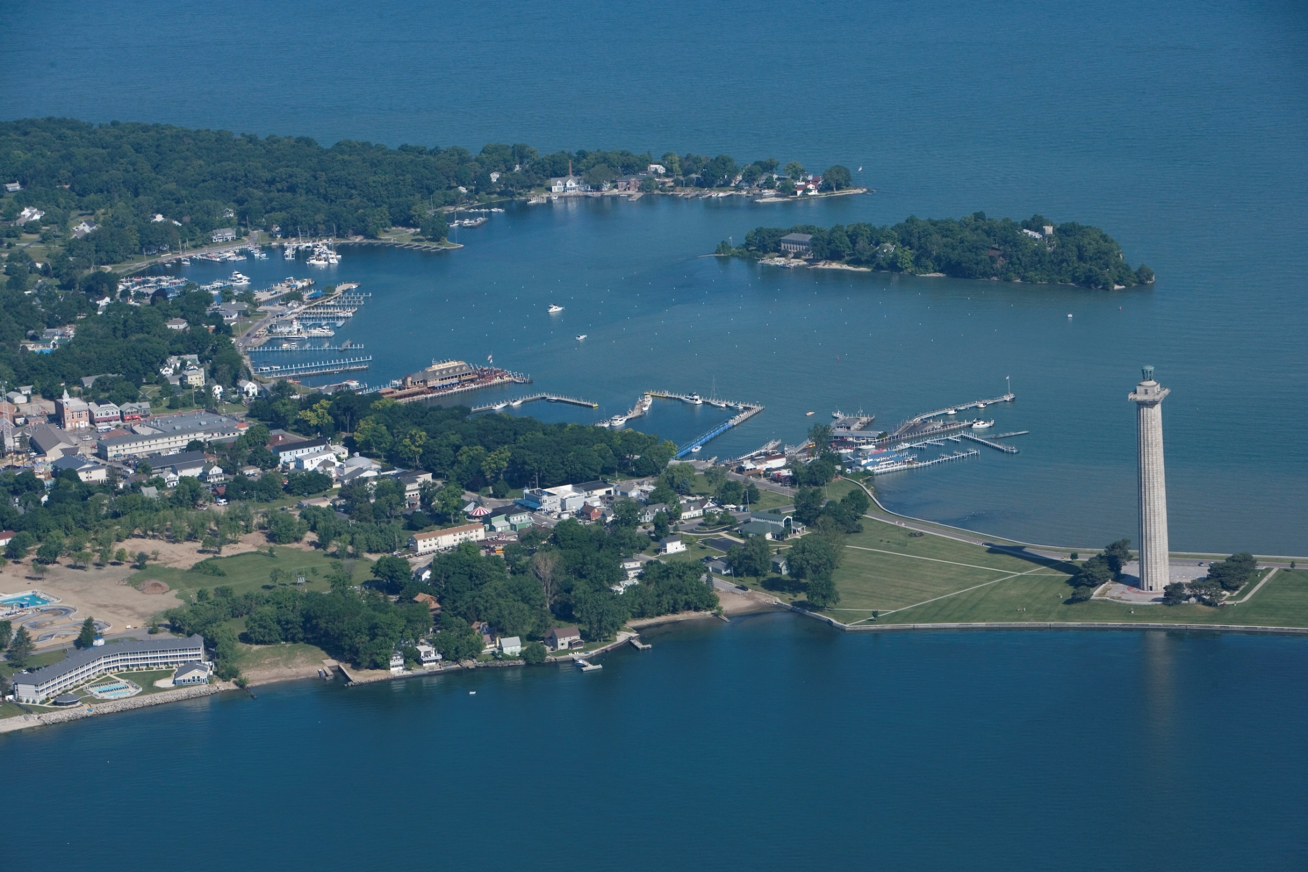

Slide 6
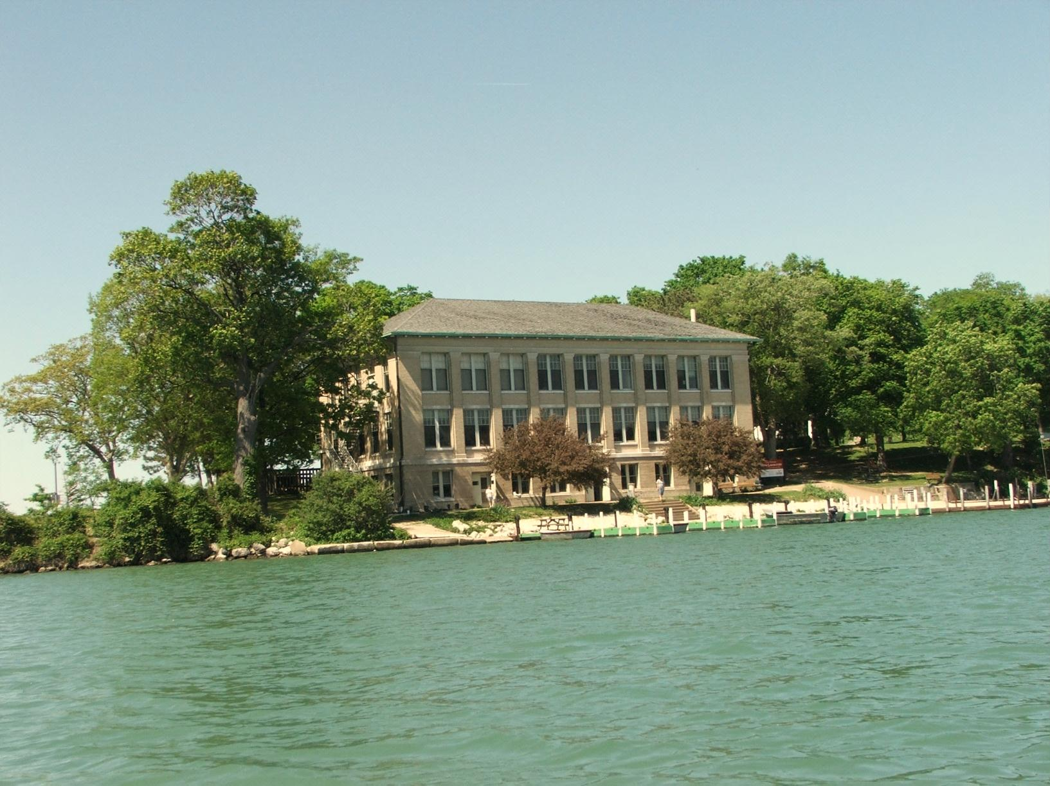
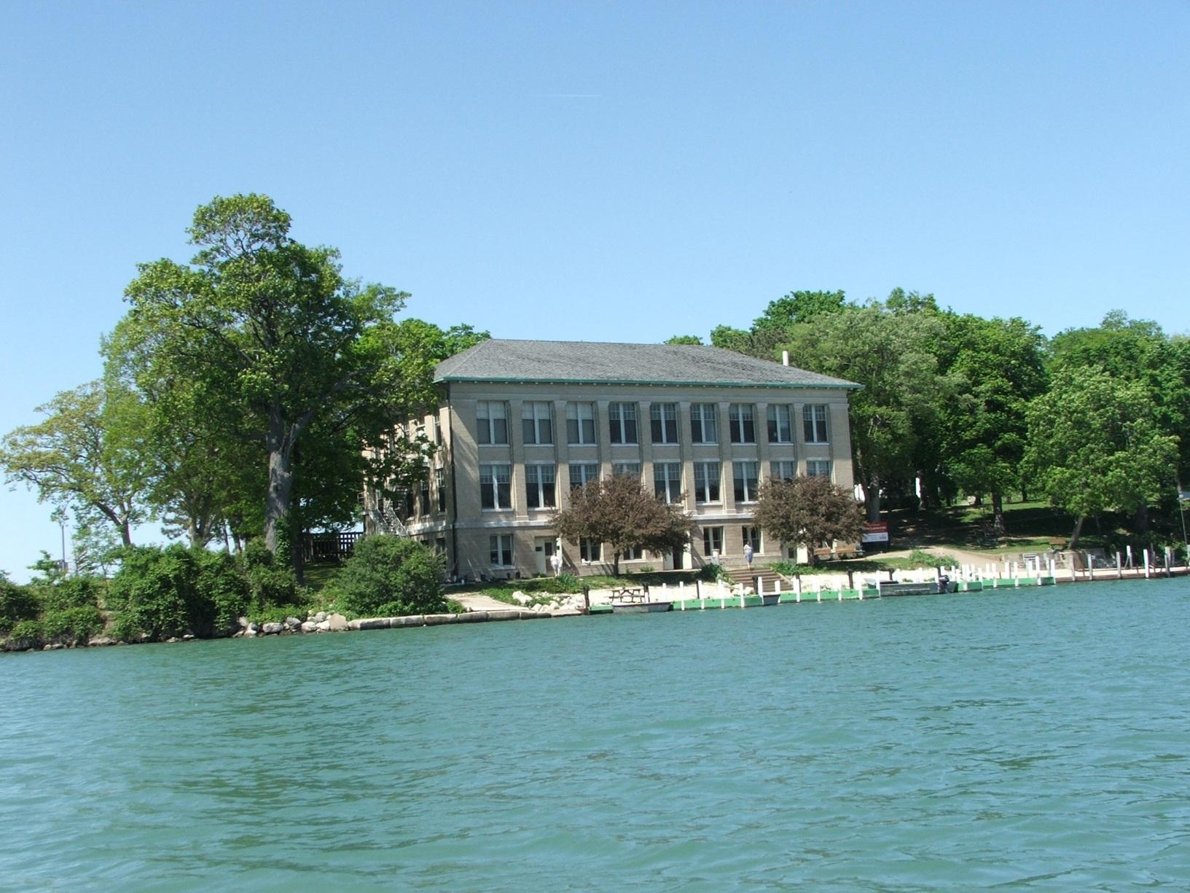
Stone Laboratory: Ohio’s Lake Erie Laboratory
Since 1895

Slide 7
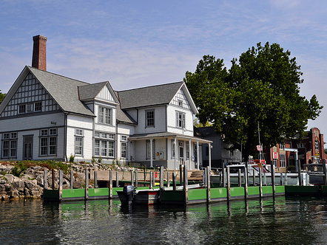
Research Building with
AVC in Background

Slide 8
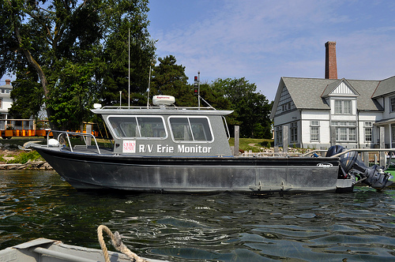
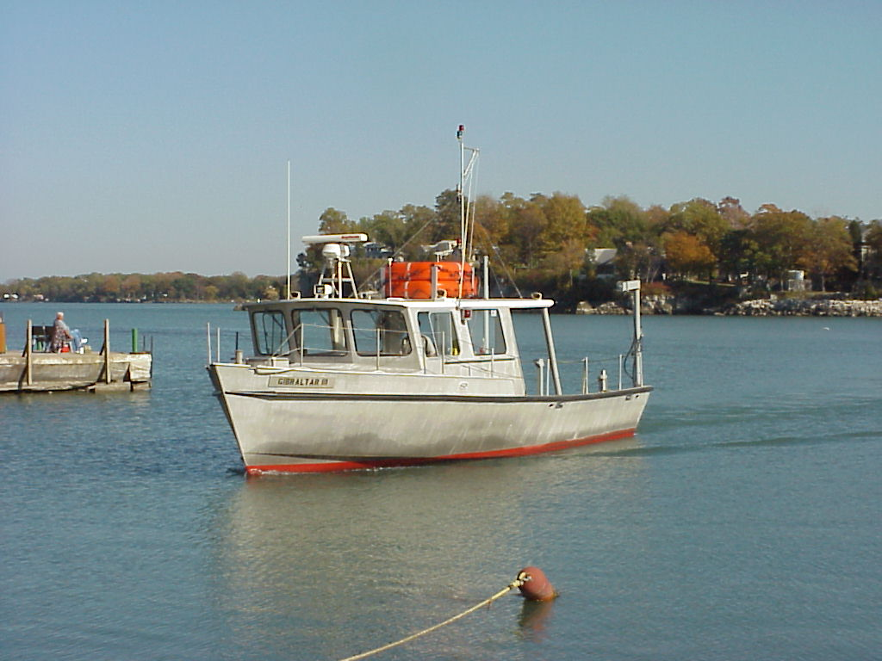
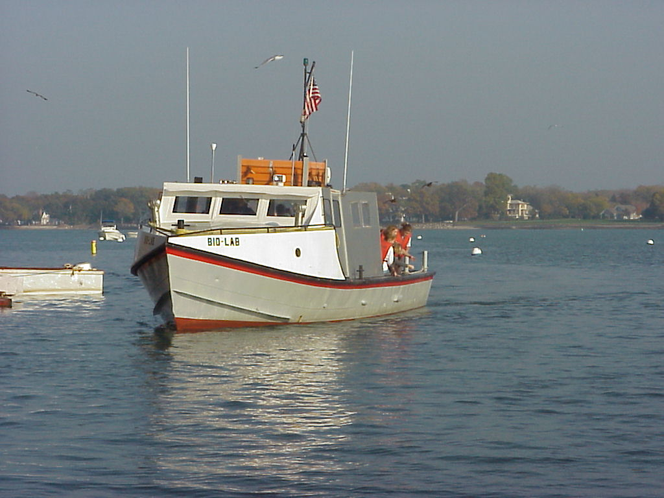
Research Vessels

Slide 9
Sea Grant and Stone Lab
Research, education (k-gray), outreach to public
Based at OSU, but involve all Ohio colleges
Focusing Ohio’s universities on real-world problem solving
Stone Lab—20 courses, training for private sector and agency managers, visited by 20,000 people/yr
Website—10 million hits/yr
Leverage over $16/state dollar invested in the program
6 Extension specialists
Biennial RFP for Research open now

Slide 10
Sea Grant and Stone Lab: Since 1978
500+ Sea Grant Projects
  500+ grad and undergrad students supported
  290+ principal investigators at over 20 colleges and universities
FOSL over 1300 scholarships at Stone Lab
82 REUs

Slide 11
Improving Science Education in Ohio:
Stone Laboratory Story
Education for all ages
  Field trips grades 4-adult
  Intro courses open to superior HS students
  Upper level courses for grad students
  Teacher courses
Since 1990:
  Students from
  111 colleges
  366 high schools

Slide 12
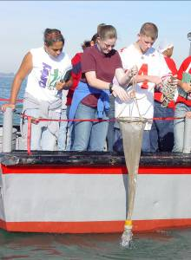
Aquatic Science
Field Trips/Workshops
200+ groups annually
Grades 4 -adult; 1 or 2-day
8,000 people annually
Program includes
  Science cruise on vessel
  Bird/Plant/Insect hike
  Fish Dissection in Lab
  Limnology Lab

Slide 13
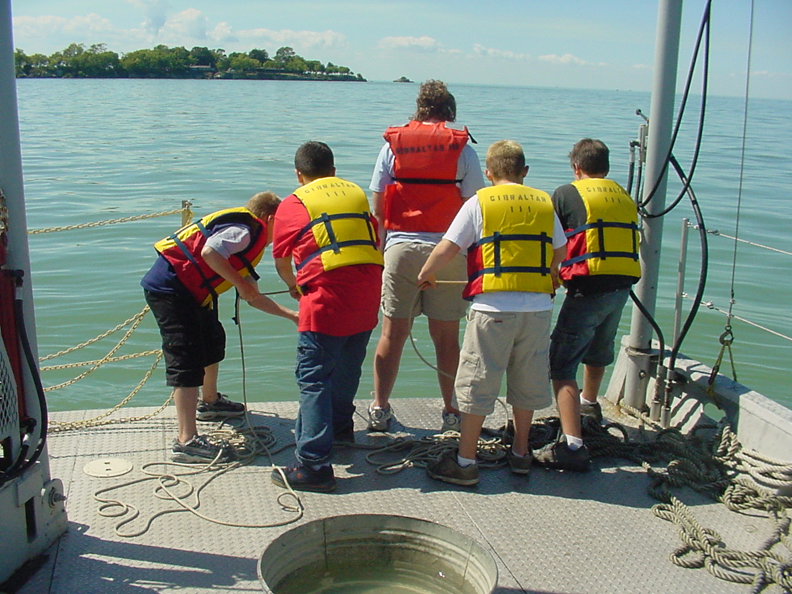
Trawling for Fish

Slide 14
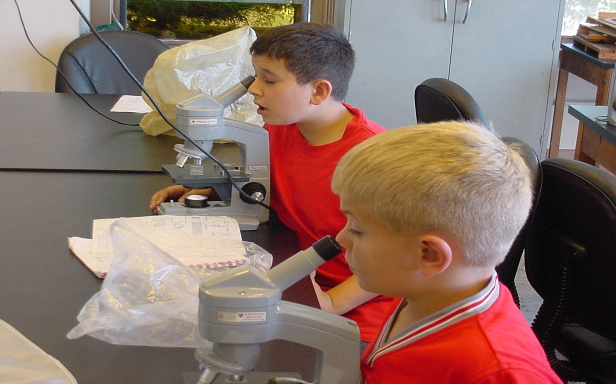
Examining Plankton Sample

Slide 15
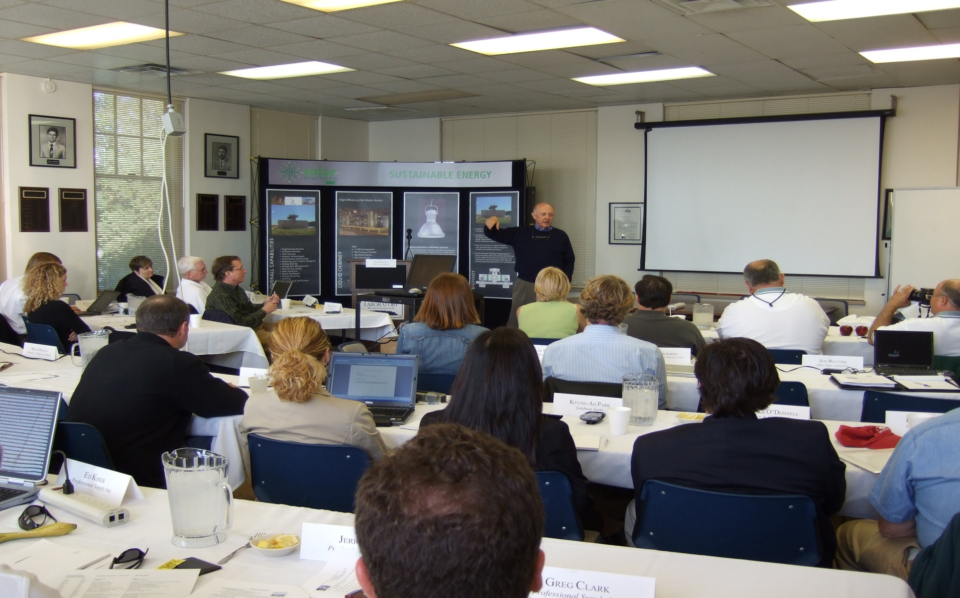

Slide 16
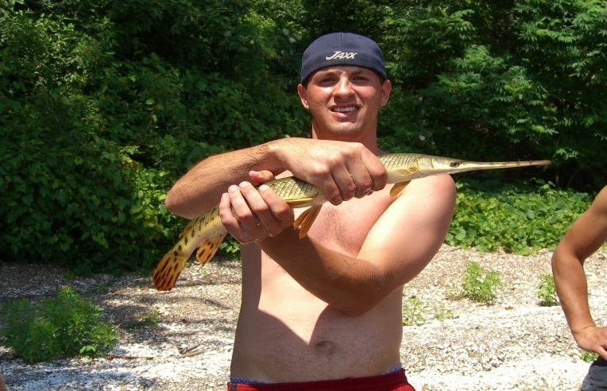
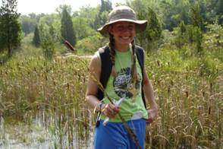
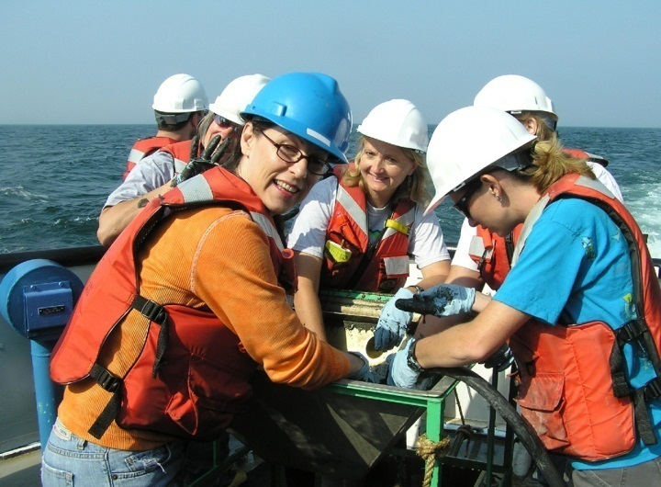
Upper Level Courses
Stone Laboratory: Ohio State’s Island Campus
One 5-week term
4 credit hours/course
Classes M-W-F or T-R-S
Ecology
Evolution
Field Zoology
Ichthyology
Aquat Ecosystems—Ecology of Inland waters (Limnology)

Slide 17
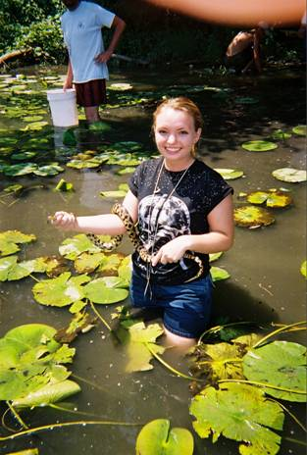
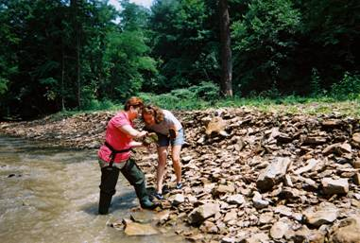
Introductory Courses
Stone Laboratory: Ohio State’s Island Campus
1-week Sunday through Saturday, 2 credits
Sport Fishing
Intro Aquat Bio
Intro Oceanography
Intro Local Plants
Intro Insect Bio
Ecol & Cons of Birds

Slide 18
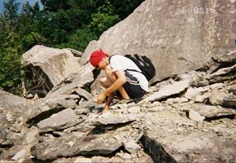
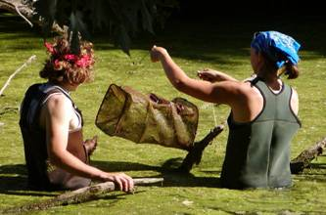
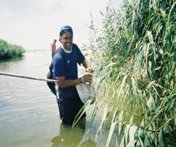
1-week Courses for College Students & Teachers
Stone Laboratory: Ohio State’s Island Campus
Geologic Setting
Spider Biology
Field Ecology
Oceanography
Herpetology
Local Flora
Climate Change Education Workshop
Climate & Sustainability
Larval Fish ID

Slide 19
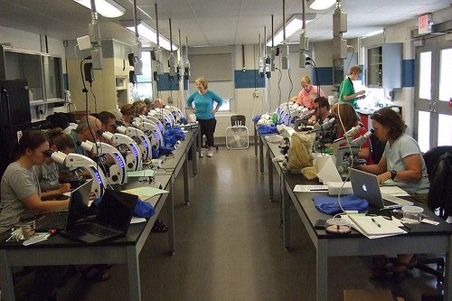
Workshops
Algal identification
NOAA Science Literacy
Dealing with Cyanobacteria, Algal Toxins and Taste and Odor Compounds
Outdoor Photography
Lake Erie Sport Fishing
Fish-Sampling Techniques

Slide 20
Opportunities to Visit Stone Lab
AVC: Wednesday through Saturday
South Bass Island Lighthouse: Mondays and Tuesdays
Gibraltar Island
  Wednesdays 11:00-1:00
  Thursday evening Guest Lecture Series
  Winter Program, 30 Jan 2013 (Columbus)
  Work Weekend, April 2013
  State Science Day, St. John’s Arena, May 2013
  Open House Saturday, September
  Buckeye Island Hop, Early October 2013

Slide 21
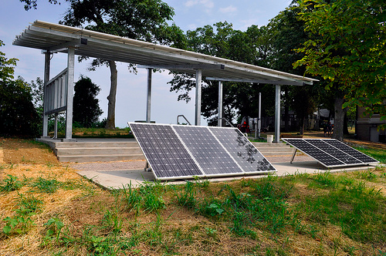
New Solar Pavilion

Slide 22
Solar Thermal on
Dining Hall Roof

Slide 23
Contact information:
Dr. Jeff Reutter, Director
Ohio Sea Grant and Stone Lab
Ohio State Univ.
1314 Kinnear Rd.
Col, OH 43212
614-292-8949
Reutter.1@osu.edu
ohioseagrant.osu.edu
Stone Laboratory
Ohio State Univ.
Box 119
Put-in-Bay, OH 43456
614-247-6500

