Slide 1
Great Lakes Protection Fund
1988: Governors of Great Lakes states agree to commit $100 million (Indiana never joins ends with $88 million)
2/3 to be managed by Board of Directors (2 from each state) appointed by the Governor
1/3 goes back to states and each state determines it use
GLPF is a source of funding for you
Russ Van Herik, Executive Director, Chicago

Slide 2
Lake Erie Protection Fund
Revenue for the Fund generated by sales of the Lake Erie license plate
Research and implementation projects to benefit Lake Erie and its tributary watersheds
Projects must be linked to the Lake Erie Protection and Restoration Plan
Many projects addressing nutrient processes

Slide 3
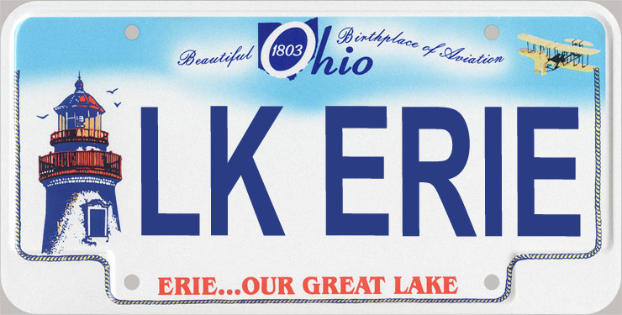
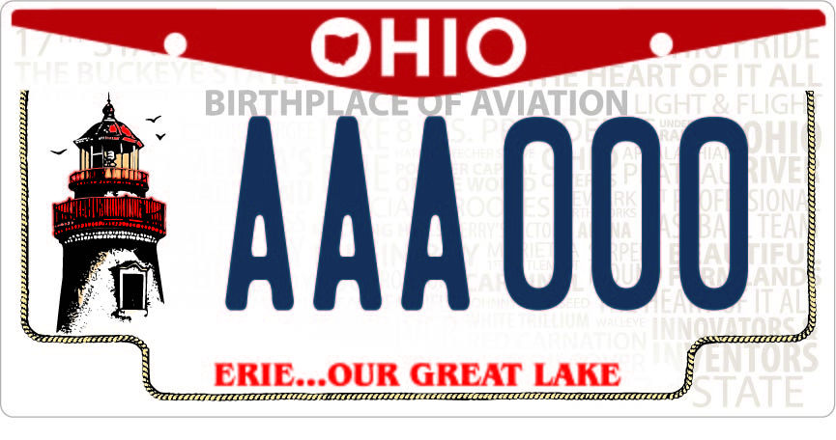

Slide 4
Ohio Lake Erie Phosphorus Task Force 2
April 2010: Final report of the first Ohio Lake Erie P Task Force
PTF2: build momentum from PTF1 and several other initiatives
Bring a science-based analysis to policy recommendations
Focus on loading targets; Ohio’s ‘share’ of the overall load
Will likely include research needs

Slide 5





111 East Shoreline Drive
Sandusky, Ohio 44870
419-621-2040
lakeerie.ohio.gov
Gail Hesse
Executive Director
lakeeriecommission@lakeerie.ohio.gov
Find us on Facebook! www.facebook.com/ohiolakeeriecommission
Follow us on Twitter! @OhioLakeErie
Check out our YouTube channel!
http://www.youtube.com/user/OhioLakeErie

