Slide 1
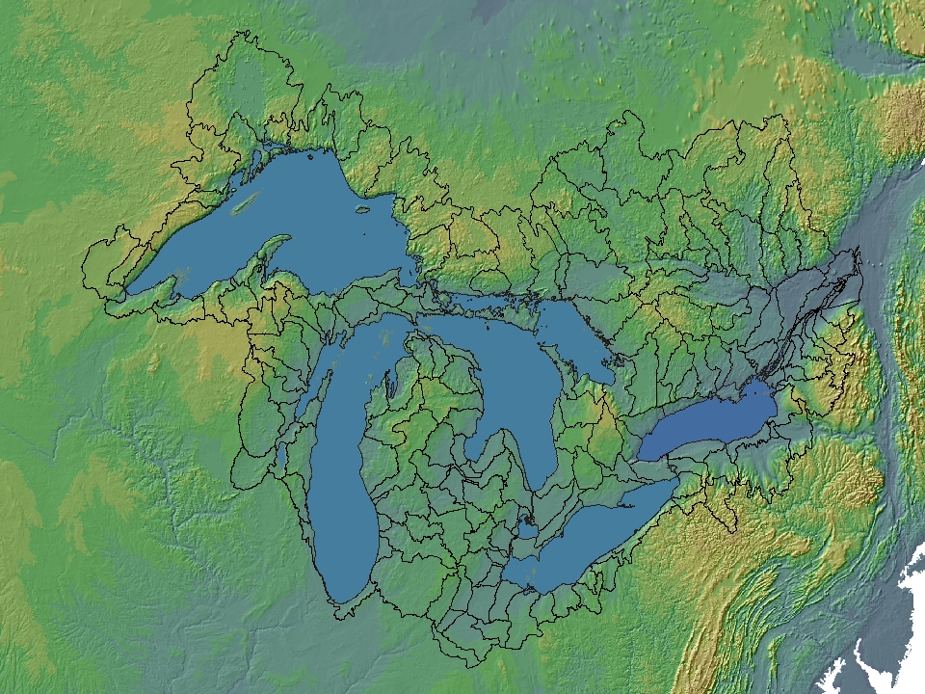
Great Lakes Water Levels and Coastal Systems
Coastal Resiliency and Climate Change
Scudder D. Mackey, Ph.D.
Ohio Department of Natural Resources
Lake Erie Millennium Conference
October 30, 2013

Slide 2
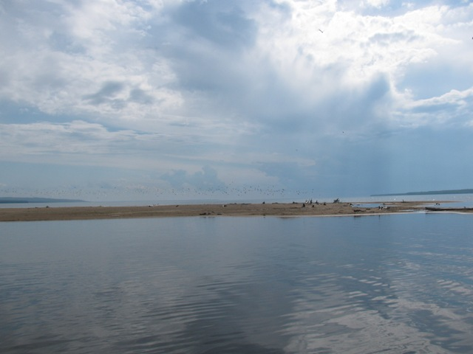
What Drives Water Level Change?
Climate
Precipitation + Runoff – Evaporation = NBS
Seasonal changes in climate (annual)
Inflows and Outflows
Connecting Channel Flows between Lakes
Water-Level Regulation
Diversions (into and out of basin)
Consumptive Uses
Wind and Storm Events (short term)

Slide 3
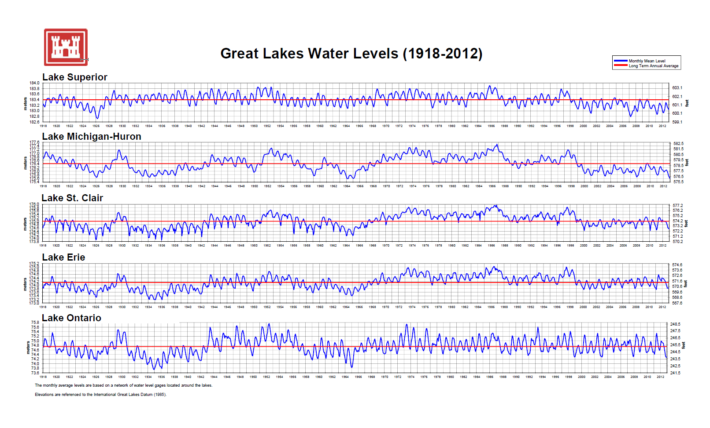
Basinwide Drop in
GL Water Levels

Slide 4
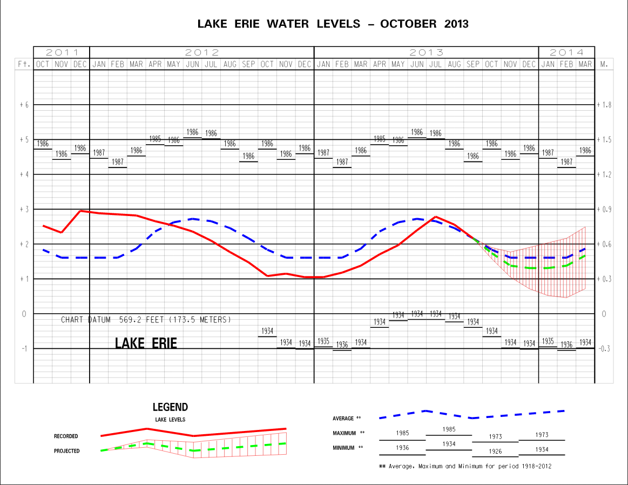
August 2013 Forecast

Slide 5
Climate Variability and Water Levels
According to the most recent climate models, climate change in the Great Lakes basin during the next 30-70 years is likely to be characterized by:
Increase in storm severity - an increase in precipitation and more frequent and intense storms (weather variability);
Increase in evaporation - an increase in lake evaporation resulting from higher surface water temperatures, increased wind speed, lack of winter ice;
Change in seasonal timing - increased water supply during winter/spring months (increased precipitation) accompanied by larger decreases in supply during summer/fall months (increased evaporation) resulting in slight overall annual declines in Great Lakes water levels.
Notes:
We've used two types of climate models in our studies - the global climate models, and the more localized Regional Climate models, adapted to the Hydroclimatology of the Great lakes.
The GCMs generally show the following characteristics a much wider range of low and high water levels. Overall, the RCMs predict that NBS will be near historic norms - certainly well within the band of paleo-climate excursions.
5

Slide 6
Future Lake Erie Water Levels
Lake Erie water levels are anticipated to remain below long-term historic mean water levels, but generally within the range of historic water levels.
Anticipate more extreme and variable water level events, i.e. anticipate water level regimes that may exceed historic thresholds, both low and high.
How might these changes impact the Lake Erie coast and shorelines?
How vulnerable is our coast to these stressors?
What can we do to adapt to minimize the impact of environmental and socio-economic climate stressors?

Slide 7
Changes in Water Level Regime
Major shifts in shoreline position/location
Loss of hydraulic connectivity
Wetlands
Small tributaries
Loss of wetlands and fish spawning/nursery habitat
Changes in seasonal magnitude, timing and duration
Seasonal highs and lows
Intermittently exposed Western Basin reefs (Lake Erie)?
Altered tributary flows and Lake circulation patterns
Connectivity between spawning and nursery habitats
Nutrient and contaminant loadings
Altered littoral sediment transport rates (nearshore habitat)

Slide 8
Coastal Habitat Enhancement Initiative
Collaborative effort between the Ohio Division of Wildlife, University of Toledo, Ohio EPA, and ODNR Office of Coastal Management
Shoreline alteration affects fish species diversity and abundance
Armoring alters diversity but response is variable based on underlying substrate/habitat types
Shoreline/terrestrial vegetation positive effect
Develop habitat use index and develop model to simulate future shoreline conditions
Stratify management goals based on shoreline types

Slide 9
Coastal Habitat Outreach, Education, Implementation and Research
Habitat Enhancement Flyer
Background
Results
Suggested Actions
Fish Photos/Community Groupings
Importance (GL Fishery, Benefits)
Develop Habitat Enhancement Guidance
Distribution at pre-application site visits (OCM)
Incorporation into reach-based LESEMP (OCM)
Incorporation into Coastal Design Manual (OCM)

Slide 10
Sand Resource Management
Collaborative effort between the Ohio Division of Geological Survey and ODNR Office of Coastal Management
Calculate volume of coarse-grained sediment contributed to the littoral zone by bluff erosion.
Volume is annualized and expressed as cubic yards/year. Surrogate for net sediment transport rate.
Can be used to quantify cumulative impacts of shore protection on sand resources and nearshore habitat.

Slide 11
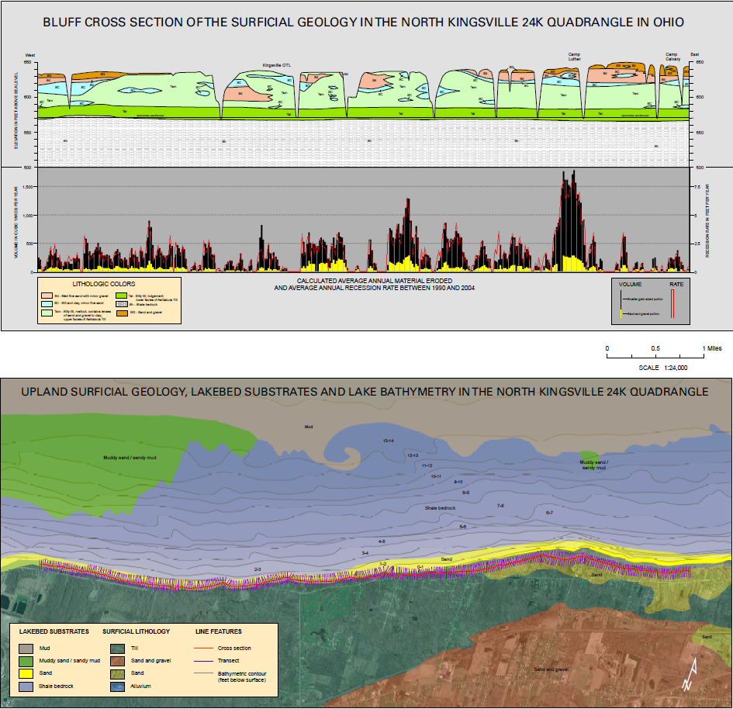

Slide 12
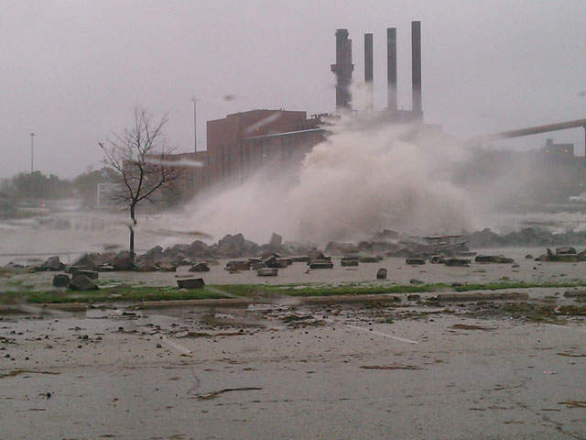
Superstorm Sandy (1-year Anniversary)
Impacts of Superstorm Sandy included sand transport landward.
Increase in beach widths
Navigation channels blocked by sand
Massive dredging effort spring 2013 a result of low Lake Erie water levels and littoral sand transport by Sandy.
Nearshore habitat impacts are unknown. Limited baseline data. Change detection not possible.

Slide 13
Vulnerability Assessment and Thresholds for Restoration Projects
Objective is to identify water-level ranges and thresholds that minimize adverse impacts to restoration projects and provide a mechanism to anticipate potential impacts due to changing water level regimes.
What parameters are required for your restoration project function successfully?
What are the thresholds beyond which your project will be severely compromised and eventually fail?
Is it plausible that those thresholds will be reached or surpassed?
If so, can you modify the design such that functionality is maintained or enhanced?
If not, are there alternative functional benefits that would accrue under a different set of conditions? (e.g. fish habitat converts to wetland habitat)
Notes:
Vulnerability and Threshold concepts…

Slide 14
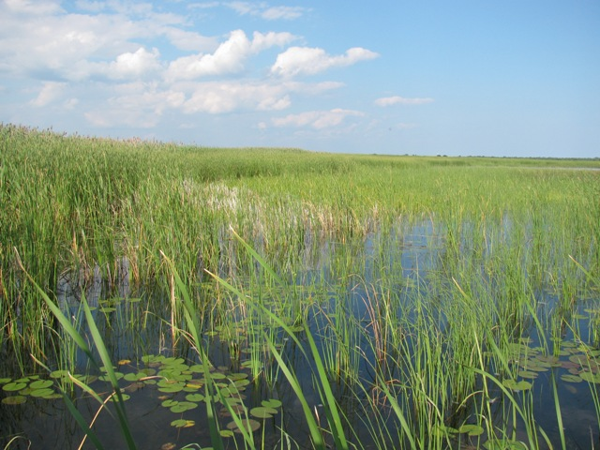
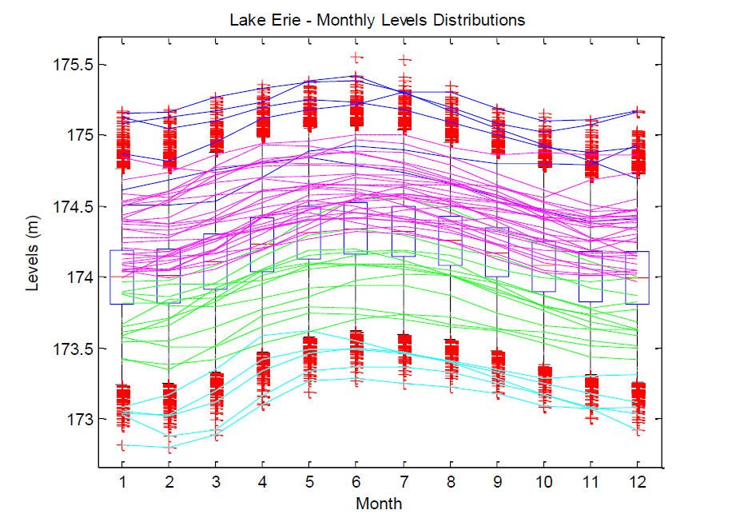
How High is “High” and how Low is “Low”?
575.5
1.2 ft
574.3 (1986)
1969 - 1998
571.3 (mean)
1933 - 1945
568.2 (1934)
0.9 ft
567.3

Slide 15
Summary
Lake Erie water levels are anticipated to remain below long-term historic mean water levels, but generally within the range of historic water levels.
Anticipate more extreme and variable water level events, i.e. anticipate water level regimes that may exceed historic thresholds, both low and high.
Areas for future research/data needs:
Future water level regimes (maximum and minimum values, duration)
Nearshore habitat enhancements (biotic and abiotic linkages)
Bathymetry, substrate, shoreline condition assessments
Nearshore aquatic communities, habitat linkages
Sand resource management (environmental and economic impacts)
Distribution, source areas, littoral sediment transport rates and direction
Low and High Water Thresholds (magnitude and duration)
Ecological impacts, design criteria for restoration and enhancement projects
Nearshore and Coastal Vulnerability Assessments
Climate change and water level regime scenarios

Slide 17
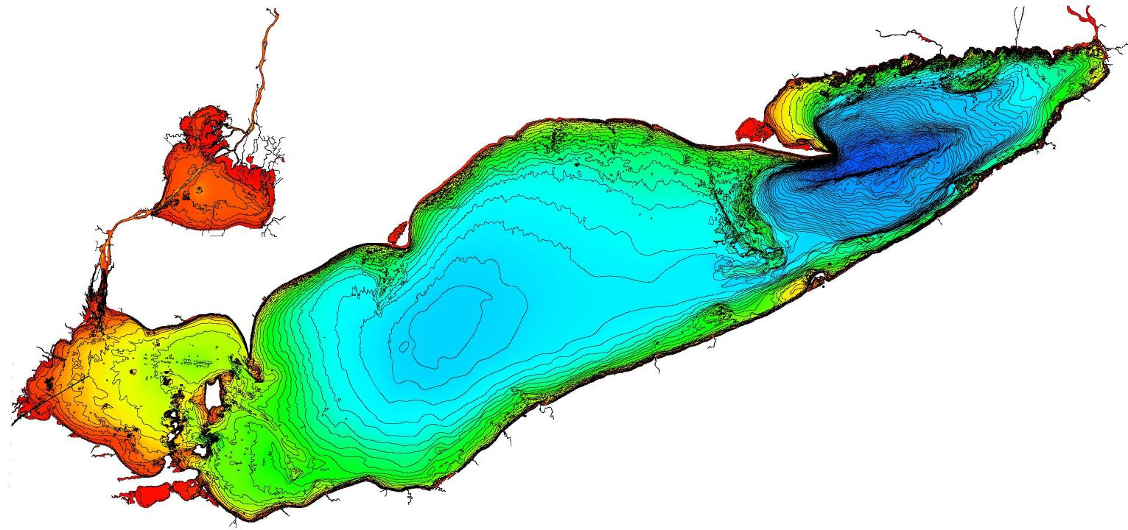
Lake Erie Bathymetry
Lake
St. Clair
Eastern Basin
Central Basin
Western Basin

Slide 18
Hydrological Components
Lake Superior
Lake Superior
56% precipitation
40% runoff
4% diversions
----------------------
43% evaporation
57% outflow
Hydrologic Values 1948-2006
Long Lac/ Ogoki
154 m³/s (5400 cfs).
Lake Ontario
79% inflow
15% runoff
6% precipitation
----------------------
93% outflow
7% evaporation
Lake Michigan-Huron
39% precipitation
34% runoff
27% inflow
----------------------
31% evaporation
68% outflow
1% Chicago diversion
St. Marys River
2110 m³/s
St. Lawrence
7060 m³/s
Lake Erie
Niagara River
5780 m³/s (204,000cfs)
79% inflow
11% precipitation
10% runoff
----------------------
89% outflow
11% evaporation
St. Clair/Detroit River
5360 m³/s (190,000 cfs)
Chicago Diversion
91 m³/s (3,200 cfs)
Courtesy IUGLS

Slide 19
Diversions and Impacts
Lake Superior
Great Lakes
+9 cm (+3.5”)
0
0
Net +9 cm (+3.5”)
Long Lac/ Ogoki
154 m³/s (5,400 cfs).
Connecting Channel
Diversion in
Diversion out
Diversion within
Lake Michigan-Huron
Sault St. Marie
Control Structures
+11 cm (+4.3”)
-6 cm (-2.4”)
-4 cm (-1.6”)
Net +1 cm (+0.4”)
Cornwall Massena
Control Structures
Lake Erie
Welland Canal
244 m³/s (8620 cfs)
+7 cm (+2.8”)
-4 cm (-1.6”)
-12 cm (-4.7”)
Net -9 cm (-3.5”)
St. Clair River
Chicago Diversion
91 m³/s (3,200 cfs)
Courtesy IUGLS

Slide 20
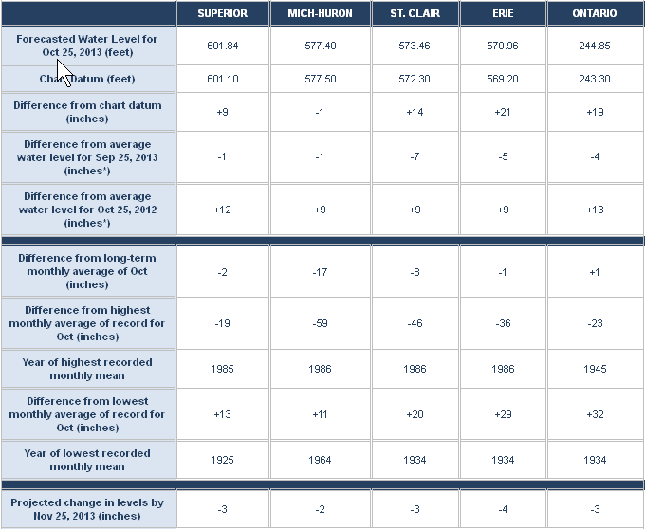
August 2013 Forecast

Slide 21
Great Lakes Nearshore and Coastal Systems Climate change impacts will directly affect the physical integrity of the Great Lakes coastal and nearshore systems, which will in turn affect the Great Lakes habitats and the ecosystem
Seasonal Changes in Water Level Regimes and Storm Frequency:
Slightly lower mean average water levels and increased water level variability – Increased potential for coastal and riverine flooding, altered coastal wetland biodiversity, loss of connectivity or inundation of coastal and riparian spawning/nursery habitats, altered marina/harbor/port access (increase dredging activity). A – high, C - >66%
Increased Storm magnitude and Frequency - Altered littoral sediment transport processes, increased shore erosion, reduced nearshore water quality, reduced marina/harbor/port access (increase dredging activity), declining open-lake spawning fish recruitment. A – high, C – >95% (medium low and 33-66% for fish recruitment)
Seasonal Changes in Precipitation
Increased spring-summer flows and runoff – Increased flows/nutrient loading promotes nearshore algal blooms, changes in seasonal flood-pulse driven spawning activity (recent Lake Erie example) A – high, C – >95% (for shallow lakes, but scale and timing issues for deep lakes <33%)
Altered Thermal Regimes:
Higher surface water temperatures - Increased primary productivity (eutrophication) and changes in seasonal timing (spawning initiated earlier/later due to thermal triggers) A - high, C - >66%
Deeper and stronger thermocline - Reduced Lake Erie hypolimnion volume and expansion of central basin hypoxia (bottom waters) A – medium high, C – 33-66% (linked to productivity, water levels)
Change in species distributions - Boundaries for up to 19 fish species would shift northward (both cold and warmwater species) A – medium high, C – 33-66%
Lower thermal constraints – Expansion of invasive species (both wetland and aquatic) A- medium low, C - >66%

