Slide 1
MANET simulation
An overview
Dr. A. K. Aggarwal
Supervisor
Faisal Mahmood
Graduate Student Nov. 10, 2009

Slide 2
Types of network
1) Wired networks
2) Wireless networks
2.1) Infrastructure networks
2.2) Infrastructure less network
Infrastructure less network is known as Ad hoc Networks
Types of Ad hoc Networks
2.2.1) Static Ad hoc Network
2.2.2) Mobile ad hoc Network (MANET)
MANET is flexible and deployment is very easy
MANET is suitable for emergency situations

Slide 3
Difficulties in manet
Difficult to handle the operations.
Each node is independent.
Topologies changes are very frequent.
Need of an efficient routing protocol.
Networks composed of a set of communicating
devices able to spontaneously interconnect without any pre-existing infrastructure.
Devices in range can communicate in a point-to-point fashion.
In addition to that, these devices are generally mobile.

Slide 4
Difficulties in manet TCP …
TCP performances are very poor in MANET
1) Tahoe
No congestion control mechanism
Slow start
Congestion Avoidance
Fast Retransmit
2) Reno
TCP-Reno added the algorithm of Fast
Recovery
3) New Reno
TCP Reno recovers only one lost packet during
the recovery process

Slide 5
Ad hoc network routing protocol
1) Pure distance vector algorithms
(e.g., Distributed Bellman Ford, Routing Internet Protocol (RIP), etc.) do not give a good result in mobile networks because of some limitation. Then some new protocols were proposed to modify and enhance the distance vector algorithm. Protocols such as Wireless Routing Protocol (WRP), Least Resistance Routing (LRR), Destination Sequence Distance Vector (DSDV) routing protocol, and the protocol by Lin and Liu.

Slide 6
Ad hoc network routing protocol
2) The protocols which are based on link state algorithms.
Theses protocols include Global State Routing (GSR), Landmark Ad Hoc Routing (LANMAR) protocol, Optimized Link State Routing (OLSR) protocol, Adaptive Link-State Protocol (ALP), Fisheye State Routing (FSR) protocol, and Source Tree Adaptive Routing (STAR) protocol.

Slide 7
Ad hoc network routing protocol
3) The third one is on-demand routing protocols which are planned only for ad hoc network.
Route to every destination of the networks on a regular basis is not maintained by on-demand routing protocols. The source establishes routes on demand. The source floods a route request packet to construct a route when it needed. The destination use route selection algorithm and select the best route for which destination receives request. Then route reply packet is sent to the source through new best route. There is no requirements of periodic exchange of route tables and control traffic overhead is greatly reduce by on-demand routing protocols. Several protocols of this type have been propose d.

Slide 8
Ad hoc network routing protocol
Ad-Hoc On Demand Distance Vector (AODV)
routing, Dynamic Source Routing (DSR), Lightweight Mobile Routing (LMR), Temporarily Ordered Routing Algorithm (TORA), Route-Lifetime Assessment Based Routing (RABR), Associatively-Based Routing (ABR), Relative Distance Micro-discovery Ad Hoc Routing (RDMAR) protocol, Signal Stability-Based Adaptive (SSA) routing, Multipath Dynamic Source Routing (MDSR), and Routing On demand Acyclic Multipath (ROAM) algorithm are on demand routing protocol.

Slide 9
Ad hoc network routing protocol
4) The fourth category is GPS (Global Positioning System)
In the early stages protocols was using node location information while building routes have been proposed recently. Through information node position, routing can require more cost to exchange location information. GPS routing protocols are Greedy Perimeter Stateless Routing (GPSR), Distance Routing Effect Algorithm for Mobility (DREAM), Grid Location Service (GLS), Location-Aided Routing (LAR), Flow Oriented Routing Protocol (FORP), and Zone-Based Hierarchical Link State (ZHLS).

Slide 10
MANETs simulation techniques
Because of the complex nature of the MANETs, their simulation is a very challenging issue.
The accuracy of MANETs simulators
The impact of granularity
Mobility models
Radio propagation models
Simulation size
Simulation acceleration techniques
Parallelism and distribution
Staged simulation

Slide 11
Elements of dependability: granularity and mobility.
Name | Granularity | Metropolitan mobility
ns-2 | Finest | Support
DIANEmu | Application-level | No
Glomosim | Fine | Support
GTNets | Fine | No
J-Sim | Fine | Support
Jane | Application-level | Native
NAB | Medium | Native
OMNet++ | Medium | No
OPNet | Fine | Support
QualNet | Finer | Support
SWANS | Medium | ------------

Slide 12
How simulators are parallelized how they can be programmed
Name | Parallelism | Interface
ns-2 | No | C++/OTCL
DIANEmu | No | Java
Glomosim | SMP | Parsec (C-based)
GTNets | SMP | C++
J-Sim | RMI-based | Java
Jane | No | Java
NAB | No | Native
OMNet++ | MPI/PVM | C++
OPNet | Yes | C
QualNet | SMP | Parsec (C-based)
SWANS | No | Java

Slide 13
MANET simulators currently in use
Name | Popularity | Licence
ns-2 | 88.8% | Open source
DIANEmu | < 0.1% | Free
Glomosim | 4% | Open source
GTNets | 0.13% | Open source
J-Sim | 0.45% | Open source
Jane | < 0.1% | Free
NAB | 0.48% | Open source
OMNet++ | 1.04% | Free for academic and educational use
OPNet | 2.61% | Commercial
QualNet | 2.49% | Commercial
SWANS | 0.3% | Open source

Slide 14
MANETs simulation study
COMMON SIMULATION PITFALLS
1) Simulation Setup
Simulation Type
Model Validation and Verification
Variable Definition
2) Simulation Execution
Setting the PRNG Seed
Scenario Initialization
Metric Collection
Generating Sufficient Runs
3) Output Analysis
Single Set of Data
Initialization Bias
Statistical Analysis
Confidence Intervals

Slide 15
Simulator and Environment
Totals | Percentage | Description
84 of 111 | 75.7% | Used simulation in the research.
0 of 84 | 0.0% | Code was available to others.
21 of 84 | 25.0% | Did not state which simulator was used.
63 of 84 | 75.0% | Stated which simulator was used
28 of 63 | 44.4% | Used the NS-2 simulator.
7 of 63 | 11.1% | Used the GloMoSim simulator
4 of 63 | 6.3% | Used the QualNet simulator
4 of 63 | 6.3% | Used the OPNET simulator
2 of 63 | 3.2% | Used the CSIM simulator
2 of 63 | 3.2% | Used the MATLAB/Mathematica.
16 of 63 | 25.4% | Used self-developed or custom simulators
41 of 47 | 87.2% | Did not state version public simulator
82 of 84 | 97.6% | Did not state operating system used
6 of 84 | 7.1% | Addressed initialization bias.
39 of 84 | 46.4% | Addressed the type of simulation.
0 of 84 | 0% | Addressed the PRNG used.

Slide 16
Plots/Charts/Graphs
Totals | Percentage | Description
82 of 84 | 97.6% | Used plots to illustrate the simulation results.
2 of 84 | 2.4% | Did not use plots to illustrate the simulation results
72 of 82 | 87.8% | Did not place confidence intervals on the plots
8 of 82 | 9.7% | Did not have legends on the plots.
20 of 82 | 24.3% | Did not have units on the data or labels
Survey results for 111 published simulation papers in ACM’s MobiHoc conference, 2000-2004.

Slide 17
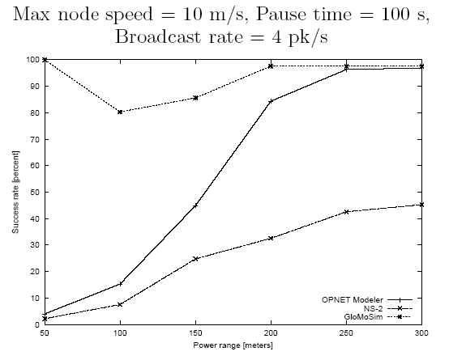
MANETs simulation comparison
1) Success rate vs. Power range
GloMoSim
OPNET
NS-2

Slide 18
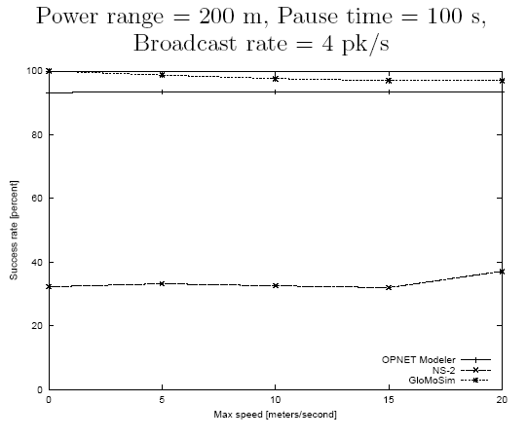
MANETs simulation comparison
2) Success rate vs. Mobility
OPNET
GolMoSim
OPNET
NS-2

Slide 19
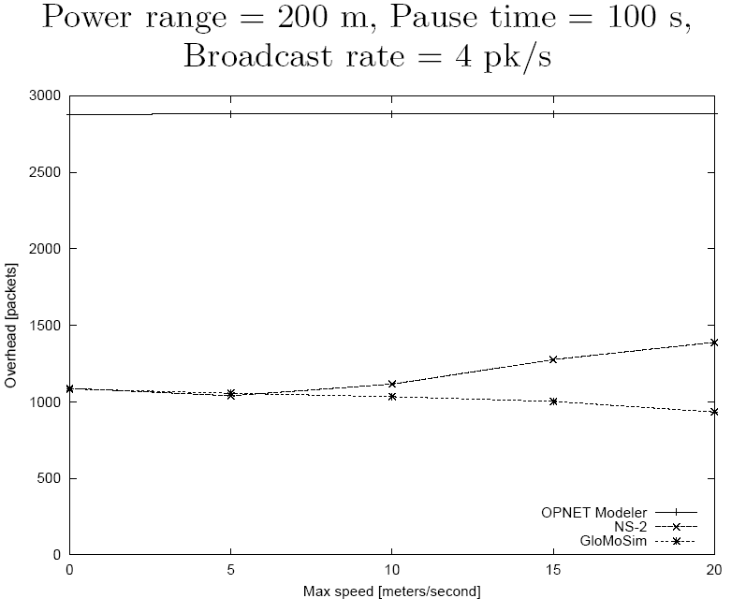
MANETs simulation comparison
3) Overhead vs. Mobility
OPNET
OPNET
GolMoSim
OPNET
NS-2
NS-2
GloMoSim

Slide 20
references
[1] PAPER
An Overview of MANETs Simulation
Laboratoire d’Informatique Universit´e du Havre France
[2] PAPER
TRASMISSION CONTROL PROTOCOL (TCP)
PERFORMANCE EVALUATION IN MANET
BLEKINGE INSTITUTE OF TECHNOLOGY
MARCH 2009
[3] PAPER
A MANET SIMULATION TOOL TO STUDY ALGORITHMS FOR GENERATING PROPAGATION MAPS
The MITRE Corporation McLean, VA 22102, U.S.A.

Slide 21
references
[4] PAPER
MANET Simulation Studies The Current State and New Simulation Tools
Stuart Kurkowski, Tracy Camp, and Michael Colagrosso
Department of Math. and Computer Sciences
[5] PAPER
Real-time simulations of Mobile Ad-hoc Networks (MANET) in Opnet Modeler H.T. Vu, M. Thoppian, A. Mehdian, S.
Vu, M. Thoppian, A. Mehdian, S. Venkatesan, R. Prakash
The University of Texas at Dallas
Richardson, TX 75083
[6] PAPER
MANET Simulation Studies: The Incredibles
Stuart Kurkowski ,Tracy Camp, Michael Colagrosso
MCS Department, Colorado School of Mines, Golden, Colorado, USA

Slide 22
references
[7] PAPER
On the Accuracy of MANET Simulators
David Cavin Yoav Sasson & André Schiper

